Slide 2

Applied Algorithm Lab
Bus inter-city

Slide 3
Bus inter-city
There are n city: 1, 2,…, n.
Between 2 cities, there may exist a bidirectional road connecting them.
Each city i has a bus route i with:
C[i]: The fare required each time a passenger boards the bus.
D[i]: The maximum number of cities the bus can travel through in a single journey using the connected roads.
Objective: Find a path from city 1 to city n with lowest cost.
Input: n, m (#roads), {C(1), D(1)},..., {C(n), D(n)}, the set of roads
Output: The minimum cost of the path

Slide 4
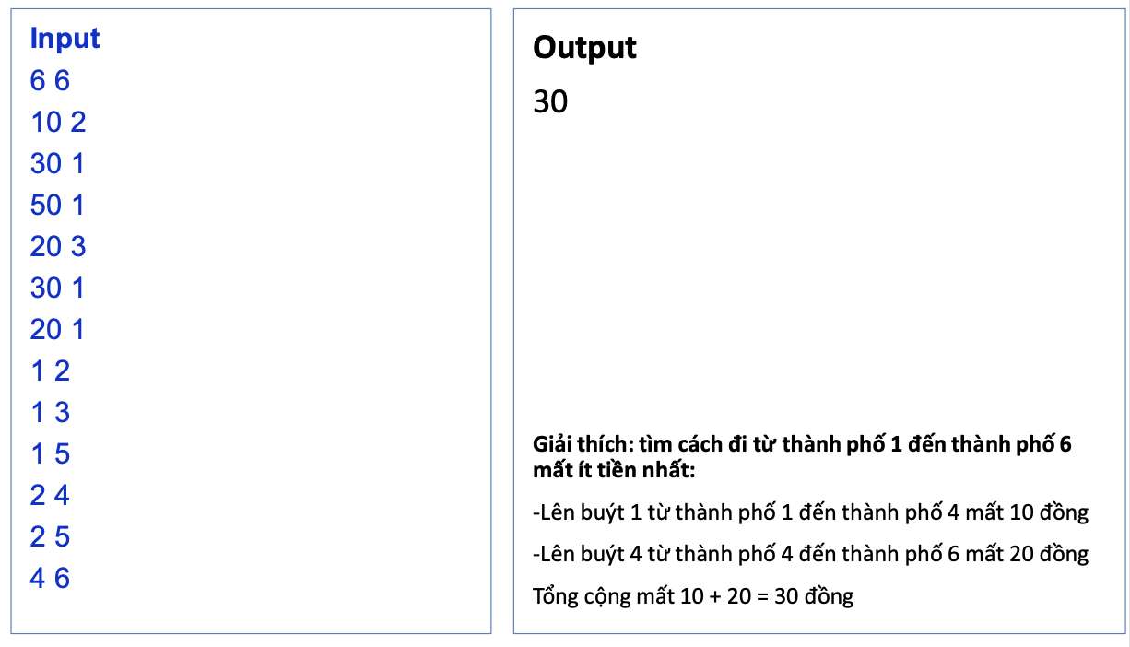

Bus inter-city
Example
Explain: the path found from city 1 to city 6 with mimimum cost is
On bus from city 1 -> city 4 cost $10
On bus from city 4 -> city 6 cost $20
Total cost: $10 + $20 = $30

Slide 5
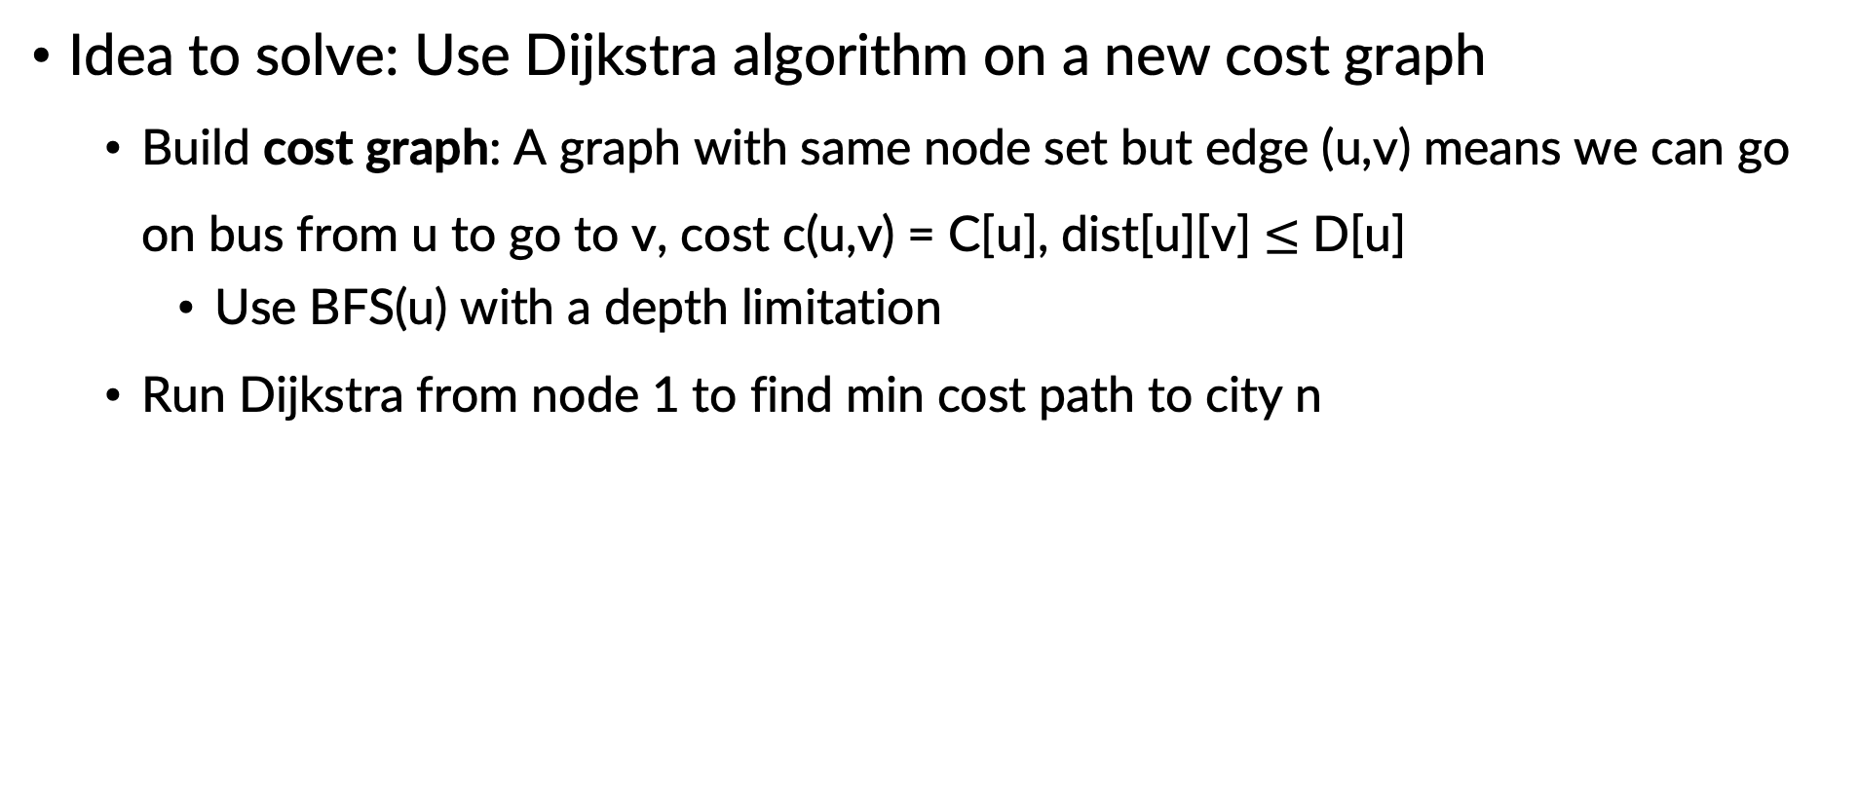
Bus inter-city
Idea to solve: Use Dijkstra algorithm on a new cost graph
Build cost graph: A graph with same node set but edge (u,v) means we can go on bus from u to go to v, cost c(u,v) = C[u], dist[u][v] $≤$ D[u]
Use BFS(u) with a depth limitation
Run Dijkstra from node 1 to find min cost path to city n

Slide 6
THANK YOU !

